Slide 1
Supporting your child with speech and language difficulties
Englefield C E Primary School

Slide 2
1.9 million children in UK have speech and language difficulties
It can affect
Every day life
Self esteem
Social relationships
Learning

Slide 3
Universal, targeted and specialist

Slide 4
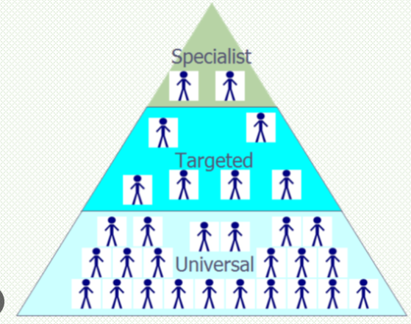
Universal strategies
Support and develop all learners
Language
Speech sounds
Spoken sentences
Vocabulary

Slide 5
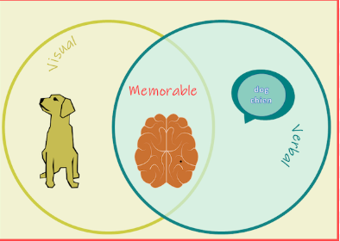
Attention
Get child’s attention before speaking
Give visual support (photos, pictures, objects)
Teach how to ask for clarification (model at home)
Make links to real life or familiar words
Simplify language
Teach active listening (look, listen, think)
Provide sentence stems

Slide 6
Processing
Give extra thinking time
Repeat instructions rather than re-phrase
Ask children to listen out for something specific
Use non-verbal cues (gesture, facial expression, pictures)
Visual support – visual timetable (reduces cognitive load and anxiety)
Countdown timers to help with knowing how long a task should take… used carefully
Objects, symbols, photos, modelling, words

Slide 7
Questioning
Blank’s levels of questioning to help comprehension
(name, describe, talk about, solve problems)
Consider children when posing questions
Simplify expectations
Model how to ask and answer questions
Sentence stems and modelled answers
Think, pair, share

Slide 8
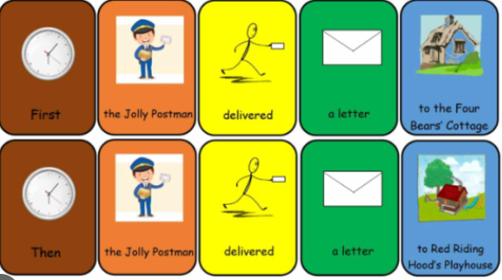
Spoken language skills
Model back correctly if making errors
Model complex structures or new language
Comment on what is happening in everyday life
Colourful semantics (bridges gap between spoken and written)

Slide 9
Vocabulary
Frayer model
Word of the week
Odd one out
Word association games
Word tennis
Guess what and guess who games

Slide 10
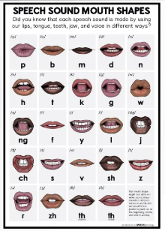
Speech sounds skills
Model back correctly
Children can show/draw/gesture
Closed questions
Take the blame for not understanding
Avoid asking them to ‘say it correctly’
Refer to sounds and phonics in words

Slide 11
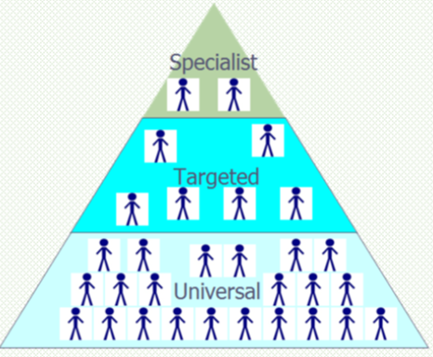
Targeted
Teachers or parents notice a difficulty
Screeners in school
Speech sounds screener
Expressive language
Receptive language
Primary resource pack from CYPIT and Online videos
Two full terms’ intervention within school before a referral is made

Slide 12
Specialist
Referral to CYPIT
Stammer referral separately
Unallocated school
https://cypf.berkshirehealthcare.nhs.uk/our-services/children-and-young-peoples-integrated-therapies/early-language-development-workshops/

