Slide 1
Supporting your child who may be struggling with reading or spelling
Englefield C E Primary School

Slide 2
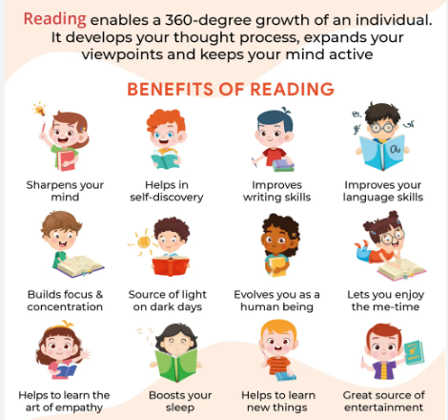

Slide 3
The importance of reading
Mental health studies show that reading is a good activity to promote well being
Vocabulary acquisition and reading for knowledge
Curriculum relies heavily on reading in KS2 and beyond
Valuable life skill
Impact on self esteem of feeling like a ‘non-reader’

Slide 4
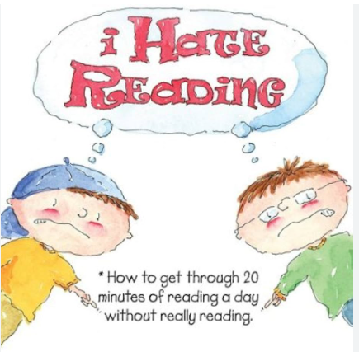

Slide 6
Strategies to help at home
Book an eye test (sometimes problems with reading are the first sign that your child may need glasses)
Paired read with your child- this takes the pressure off
Let them choose a book they enjoy- this helps increase motivation
Reader pens/ audio books/ e- readers and screen reader/ RNIB subscription/ BBC bitesize
Struggling readers will find the effort exhausting, which may lead to frustration and reluctance to learn. This is normal. You can always read to your child and discuss the book in this instance.

Slide 7
What to do if my child makes a mistake when reading aloud?
Pause
Prompt
Praise
Wait a little rather than jumping in to give the word
Say- use your sounds, or break it down
Praise them for getting it right
Or give them the word after their attempt (this helps keep the flow)

Slide 8
Barrington Stoke and Graphic Novels

Slide 9
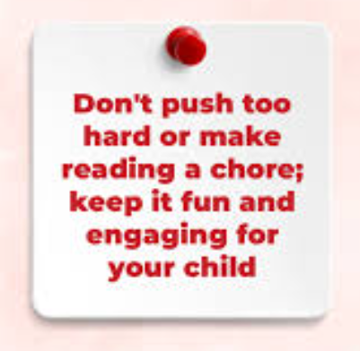
Top Tip: Make reading a positive experience

Slide 10
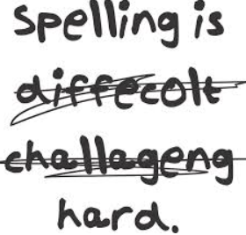

Slide 11
Why spelling matters
Self esteem
Impressions
Impact on writing (confidence, speed, quantity, vocabulary choices)
Enables the reader to easily read what you are saying which improves communication
**KS2 Grammar SAT is heavily weighted to spelling (20/70)
**KS2 writing teacher assessment places emphasis on transcription skills

Slide 13
Supporting learning spelling at home
Book a hearing test – sometimes your child may be mishearing the parts of the words which makes spelling really tricky
Phonics- try not to worry if your child is having an intervention
Acquisition of sight words (regular, irregular, high-frequency, low-frequency)
Multi-sensory, kinesthetic approach (games)
Overlearning
Sometimes whole word learning might be suggested after phonics has been taught and retaught effectively

Slide 18
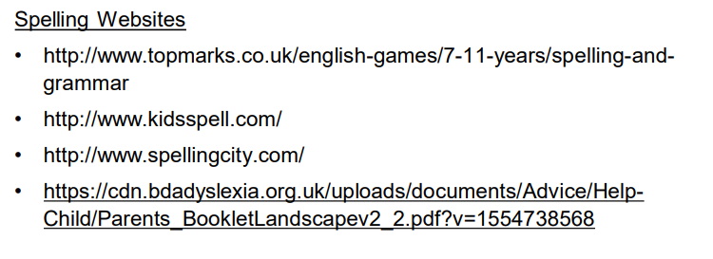

Slide 19
Would you like to learn more about this?
Class teacher
SENCo
https://www.sendstation.co.uk/
https://www.bdadyslexia.org.uk/advice/children/how-can-i-support-my-child/reading

Slide 20
Is it dyslexia?
Teachers cannot diagnose your child : only a Level 7 assessor can
Sometimes a sight issue, or time missing from education in the early years can contribute to difficulties with reading and spelling
Support in school does not rely on a diagnosis- teachers are aware that up to 10% of the population are dyslexic and will make their classrooms ‘dyslexia friendly’

Slide 21
Dyslexia has a tendency to run in families
Dyslexia occurs across the ability range
Dyslexia affects more than just reading and spelling
Dyslexia is often a co-occurring difficulty (ADHD/ASD/Dyscalculia/Dyspraxia)

