Slide 1
Parents Guide to: Zones of Regulation
Englefield C E Primary School
The Zones of Regulation is used as a way to teach and support our children to manage and regulate their emotions.

Slide 2
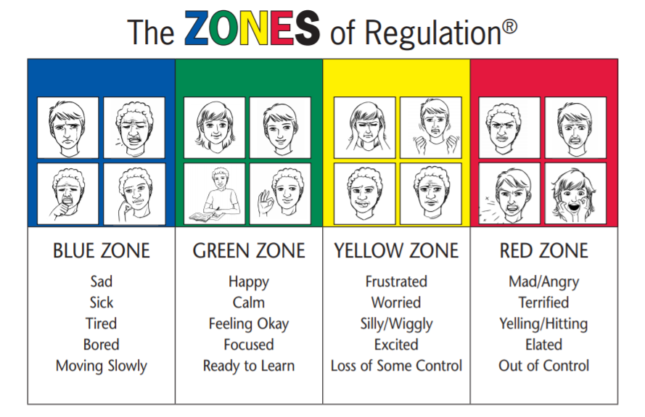
What is it?
WHAT Is it?
The Zones of Regulation is an approach which supports children in managing their feelings. By categorising the different ways we can feel and states of alertness, children can be supported to identify their own feelings and understand how their feelings can then affect their behaviour.

Slide 3
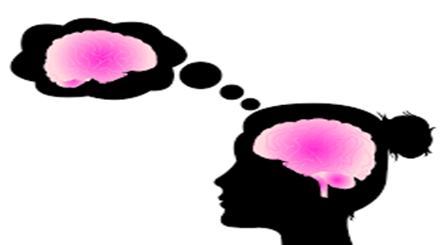
Why do we use it?
To teach our pupils:
How to identify their feelings as well as read others’ facial expressions
Understand how their behaviours can influence others’ thoughts, feelings and behaviours
How to regulate their own feelings and in doing so, develop their own ‘toolbox’ of strategies to self-manage their thoughts and emotions.
Problem solve and find positive solutions to different emotions
The ultimate goal is for independent regulation.

Slide 4
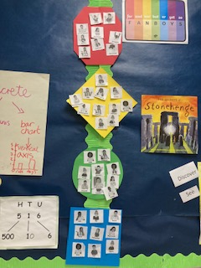
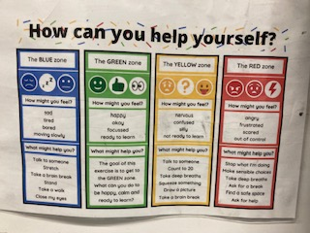
What does it look like in school and how do we use it?
Children are encouraged to talk about their feelings and emotions.
By doing so, this will support their understanding and consolidate their learning further.
Our pupils can then decide whether to check in with their feelings through the school day.
Our staff can support by reminding them of the ‘tools’ they could use to help them navigate through their feelings.
Here are some examples:
Walk away and take a movement break
Think about the size of the problem
Finding a quiet space to calm down
Breathing techniques
Fiddle toy
Drinking water
Talk to a trusted adult

Slide 5
The four zones:

Slide 6
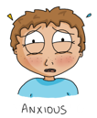
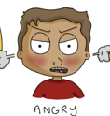
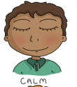
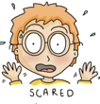
The Yellow Zone is also used to describe a heightened state of alertness and elevated emotions, however one has more control when they are in the Yellow Zone. A person may be experiencing stress, frustration, anxiety, excitement, silliness, the wiggles, or nervousness when in the Yellow Zone.
The Blue Zone is used to describe low states of alertness and down feelings such as when one feels sad, tired, sick, or bored.
The Green Zone is used to describe a calm state of alertness. A person may be described as happy, focused, content, or ready to learn when in the Green Zone. This is the zone where optimal learning occurs.
The Red Zone is used to describe extremely heightened states of alertness and intense emotions. A person may be elated or experiencing anger, rage, devastation, or terror when in the Red Zone.

Slide 7
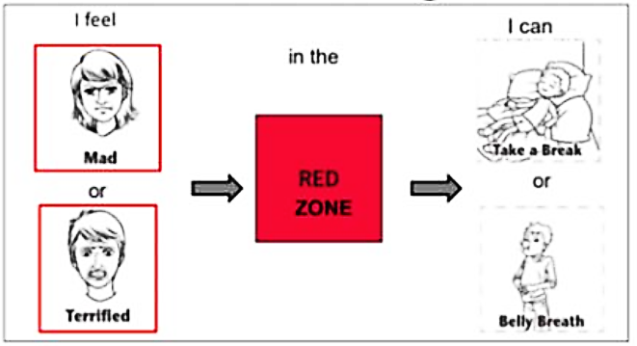
Worth remembering…the Red Zone is not a bad zone!
In fact, none of the zones are bad!
The feelings of anger, terror, devastation etc are perfectly normal to feel but what matters is how children learn to regulate and manage these strong feelings.

Slide 8
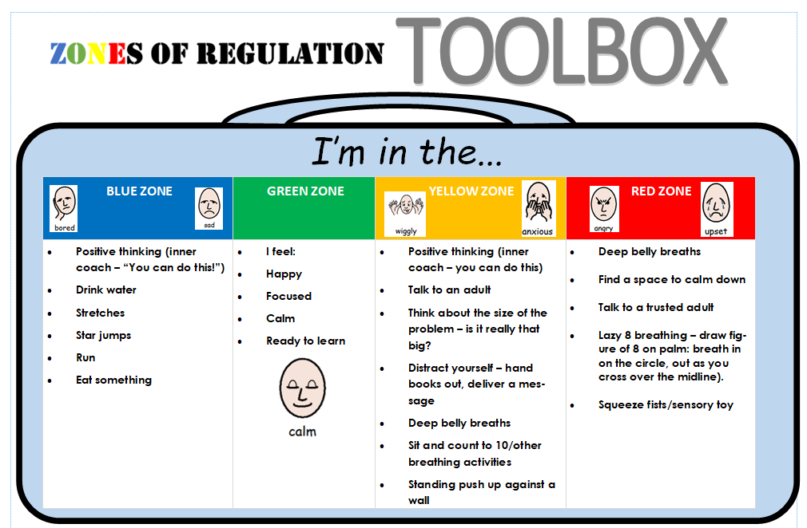
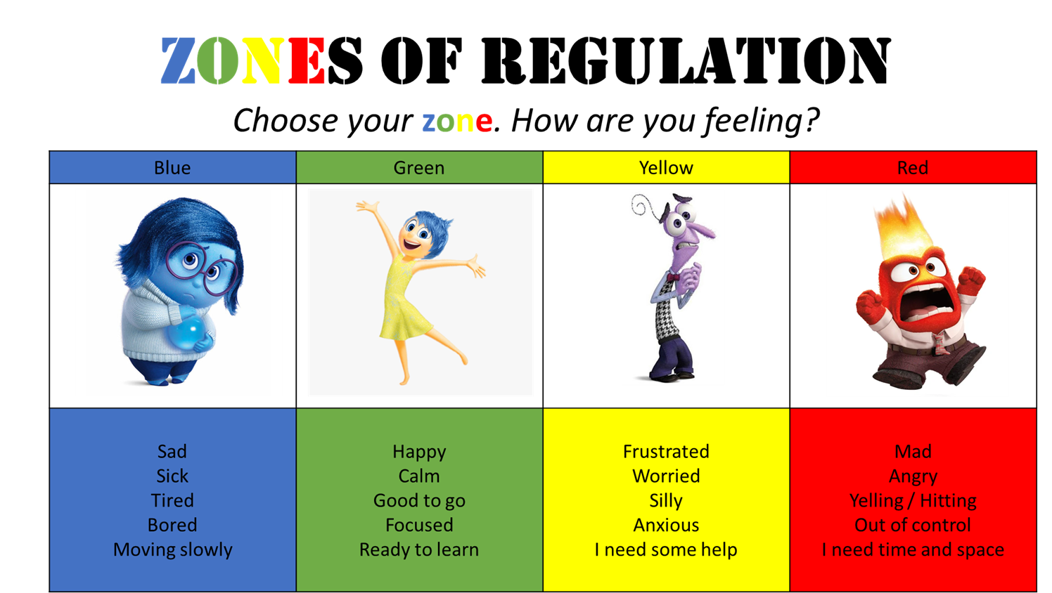
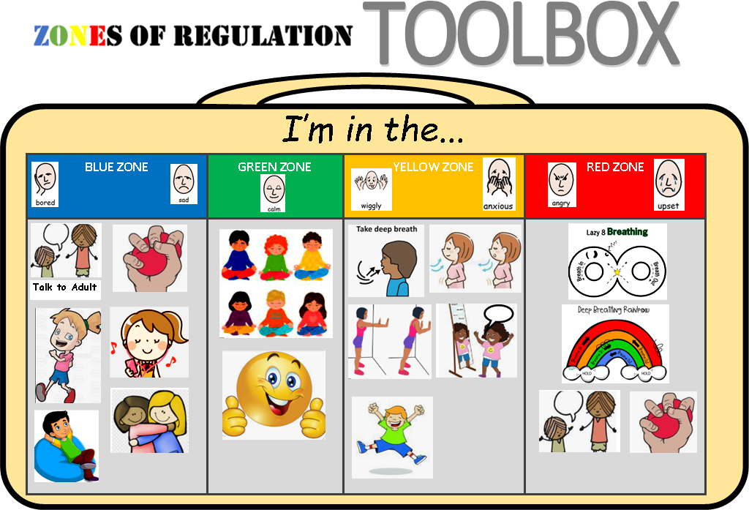
How can we use it at home?
Ask children ‘how are you feeling?’/check in with their feelings.
Identify which zone they are in. ‘Which zone are you in?’
Talk through strategies in their toolbox.

Slide 9
Any Questions?

