Slide 1
ASD and ADHD diagnosed or on the pathway
Sowing the seeds for a flourishing future

Slide 2
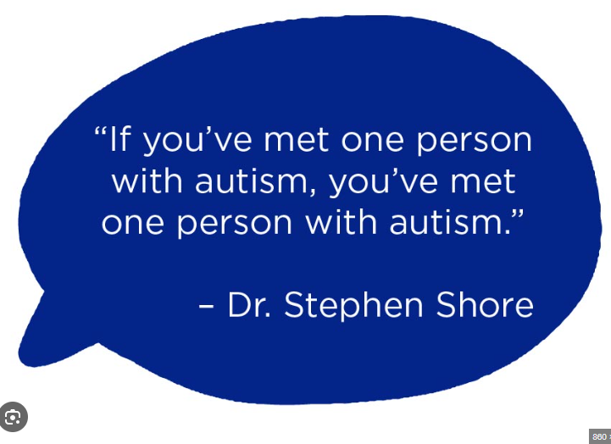

Slide 3
Sensory processing
Autistic pupils and those with ADHD (these are very often co-occurring), process and experience the world differently
NOT a deficiency, a difference
What is sensory processing? https://cypf.berkshirehealthcare.nhs.uk/health-and-development/sensory-processing/
Sensory processing in school (school is busy and noisy)
What can schools do to help?
Heavy work, sensory circuits, sensory play, sensory breaks, fiddle toys, headphones, wobble cushions, adapted/calming environment (low arousal)

Slide 5
Disregulated behaviours
We believe all behavior is communication
Curiosity (Why did you push past the child?)
PACE approach (playfulness, acceptance, curiosity, empathy)
Calm time, quiet time, time outside, screen time
Timetabled sensory diet to support better sensory integration
Part-time timetable
Alternative provision

Slide 6
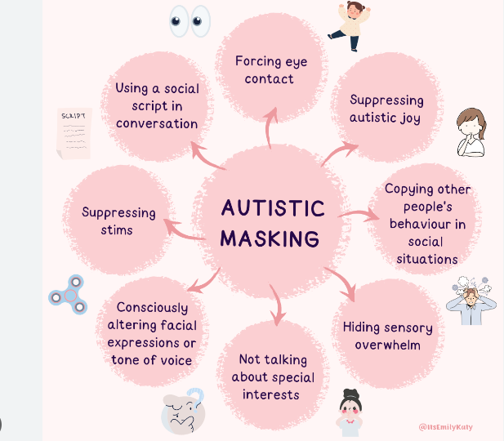
A fine line between regulated and masking….

Slide 7
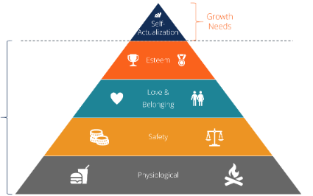
MASKING
https://www.bbc.co.uk/programmes/p0bbnh47/clips
Why mask? Sense of belonging, to avoid ‘harm’
Implications of masking:
effects core beliefs (I am not okay),
poorer mental health,
meltdowns,
after school restraint collapse,
EBSA

Slide 8
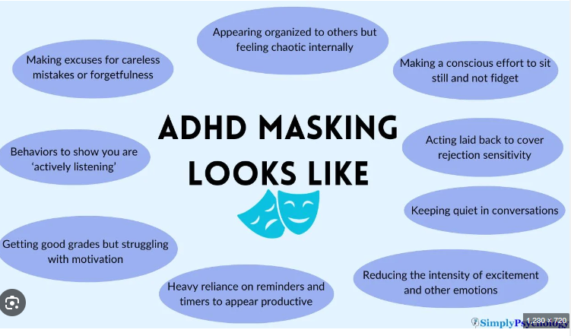

Slide 9
Authentic Autistic Behaviour is okay ☺
As a school community we would like to welcome and understand authentic autistic behavior by following these strategies:
reducing the need to mask,
raising awareness of neurodivergence,
improve self esteem and confidence to be authentic,
help pupil understand energy accounting
Work on regulation rather than masking

Slide 10
How do we support learners with ASD and ADHD or who are on the pathway at school?
Universal Provision
Curiosity and empathy
Trauma informed approached
Therapeutic approach
Sensory breaks
Fidgets, wobble cushions
Targeted provision
Sensory circuits, sensory play, ELSA, Zones of Regulation, Trusted adult, therapeutic plan, Building Blocks, Homunculous
Advice from External Professionals
CAMHs, EHA, EP, EDIT, OT, Autism Team, Swings and Smiles

Slide 11
What advice can we share as a group?
DLA apply for it (not means tested, needs based)
Trampoline
Screen time (down the rabbit hole)
Sensory rotating chair
Weighted Blankets
Squeezes work… Rolled on by an exercise ball
Join the @sendmumsclub (Rachel)

