Slide 1
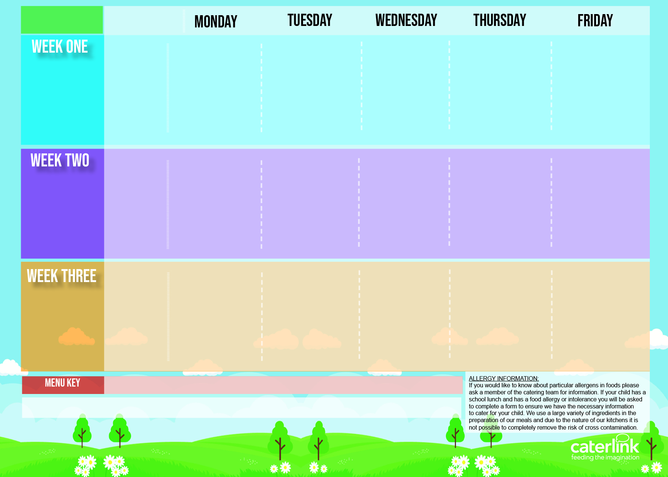
Central Autumn Winter Menu 2024 2025
NEW Tomato & Vegetable Pasta | Cottage Pie with Gravy | Roast Chicken or roast Quorn with Stuffing, Roast Potatoes and Gravy | Meatballs in Tomato Sauce with Rice | Fishfingers with Chips & Tomato Sauce
Mexican Fajitas with Rice | Cheese Swirl |  | NEW Cheese and Broccoli Pasta with Garlic Bread | Cheese and Pepper Omelette with Chips & Tomato Sauce
Jacket Potato | Tomato Pasta | Jacket Potato | Tomato Pasta | Jacket Potato
Blackberry and Apple Crumble with Custard | Melting Moment Biscuit | Rice Pudding | Fruit Platter | Marble Sponge Cake with Custard
04/11
25/11
16/12
20/01
10/02
10/03
31/03
Classic Cheese and Tomato Pizza With Potato Wedges | NEW Chicken Pasta Bake with Garlic Bread | Sausage and Mash with Gravy | Chicken Tikka Masala with Rice | Fish fingers with Chips & Tomato Sauce
 | Chinese Vegetable Curry with Rice | Vegan Sausage and Mash with Gravy | NEW Mild Mexican Chilli with Rice | Cheese and Tomato Quiche with Chips & Tomato Sauce
Tomato Pasta | Jacket Potato | Tomato Pasta | Jacket Potato | Tomato Pasta
Orange Chocolate Cookie | Jelly with Mandarins | Fruit Medley | Peach Cake | Oaty Cookie
11/11
02/12
06/01
27/01
24/02
17/03
Macaroni Cheese | Classic Cheese and Tomato Pizza NEW Caribbean Butterbean Stew with Rice and Peas | Roast Chicken with Stuffing, Roast Potatoes and Gravy | Spaghetti Bolognaise | Fish with Chips & Tomato Sauce
Plant Balls in Tomato Sauce with Rice |  | Cottage Pie with Gravy | NEW Hot Pot Baked Bean Casserole | Mexican Bean Roll with Chips
Jacket Potato | Tomato Pasta | Jacket Potato | Tomato Pasta | Jacket Potato
Chocolate and Beetroot Brownie | Sticky Toffee Apple Crumble with Custard | Fruit Salad | Iced Sponge | Vanilla Shortbread
18/11
09/12
13/01
03/02
03/03
24/03
Added Plant Power
Wholemeal
Vegan
Available Daily: Fresh Bread – Salad Selection – Fresh Fruit and Yoghurt

