Slide 1
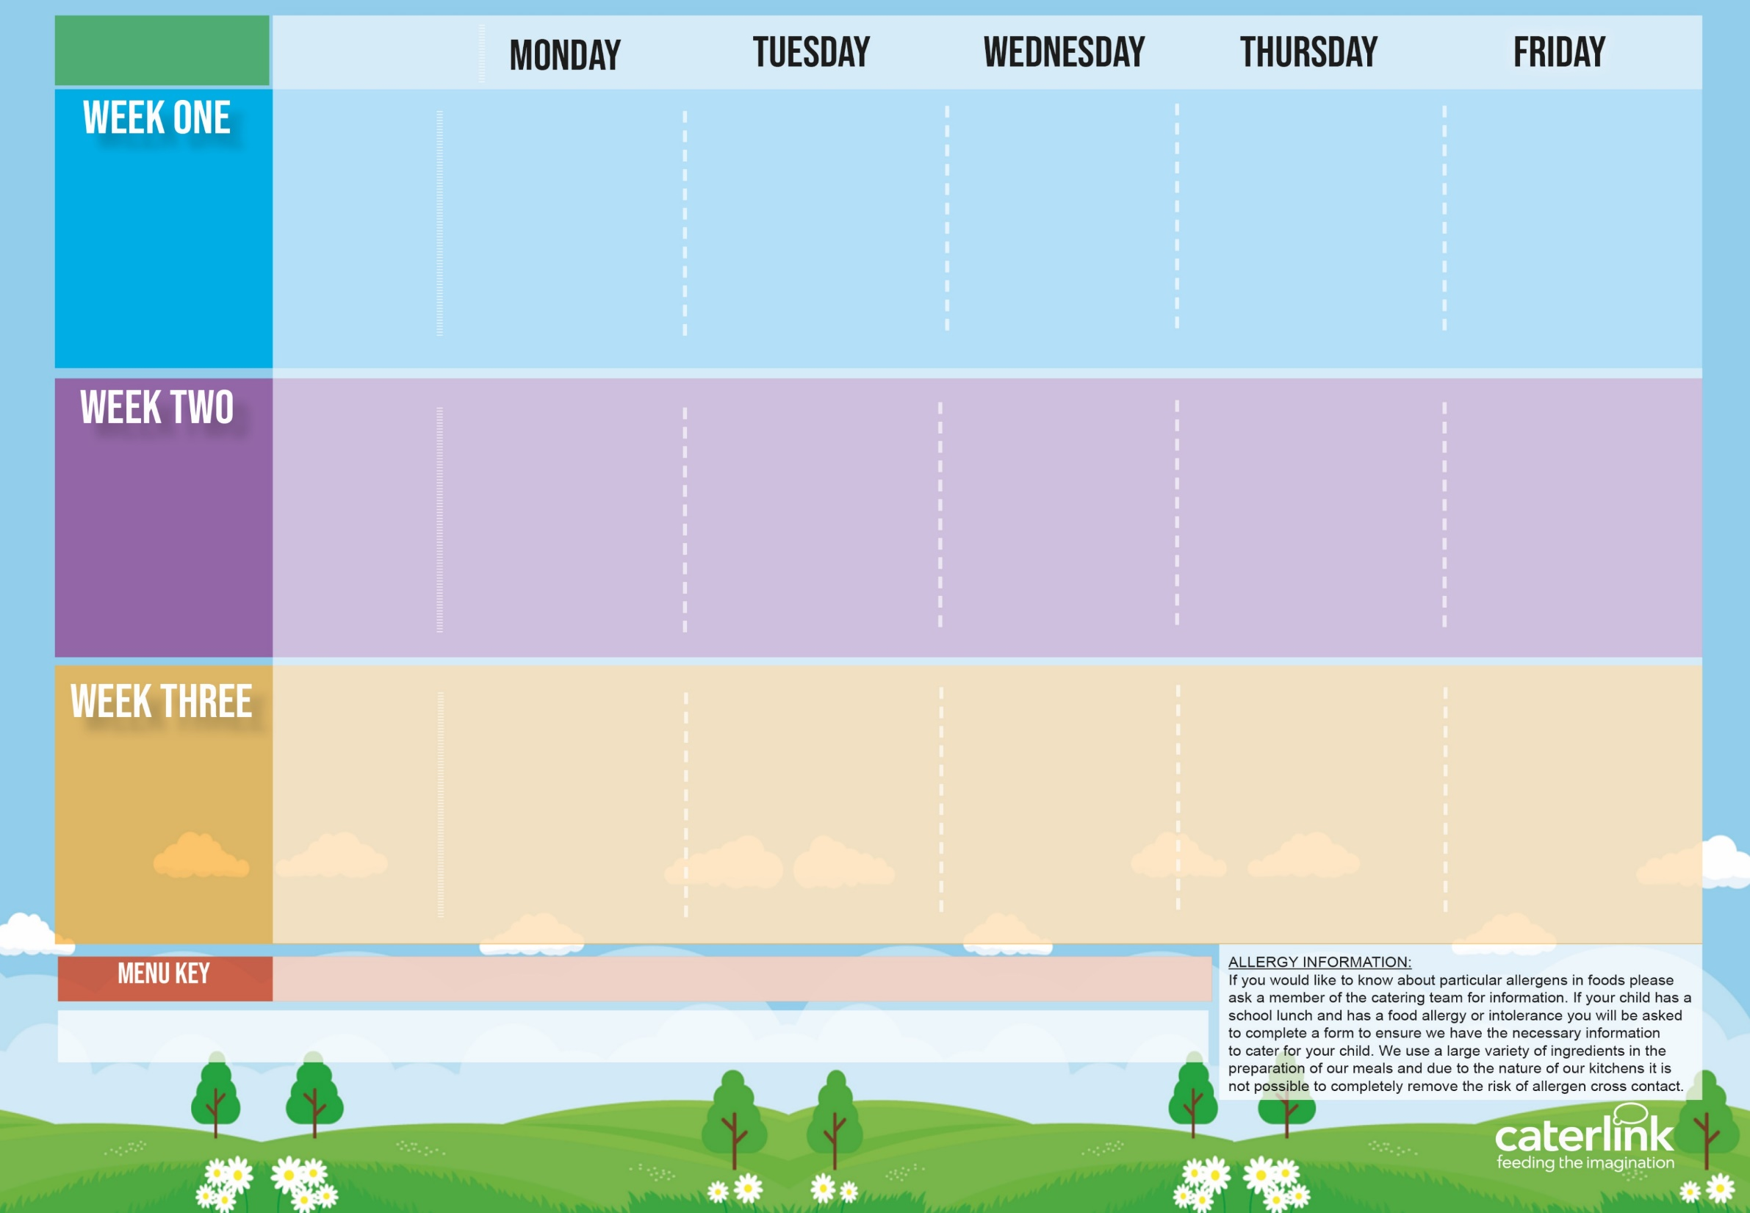
Spring Summer
2025
Option One
Option Two
Option Three
Dessert
Pasta Kitchen Tomato and Lentil Pasta | Mild Mexican Beef Chilli with Rice | Roast Turkey, Roast Potatoes & Gravy | Spaghetti Bolognaise | Fish fingers with Chips & Tomato Sauce
Macaroni Cheese | Margarita Pizza with Salad | Veg Wellington, Roast Potatoes & Gravy | Veggie Sausage Roll | All Day Vegetarian Breakfast
Jacket Potato | Pasta | Jacket Potato | Pasta | Jacket Potato
Syrup Snap Biscuit | Summer Lemon Cake | Fruit Platter | Strawberry Jelly with Mandarins | Chocolate Shortbread
23rd April 2025
12th May 2025
9th June 2025
30th June 2025
21st July 2025
Option One
Option Two
Opton Three
Dessert
Spaghetti and Plantballs | Chef Special Chicken and Chickpea Korma with Rice | Roast Chicken, Stuffing, Roast Potatoes, & Gravy | Pork Hot Dog with Wedges & Tomato Sauce | Fish fingers with Chips & Tomato Sauce
Cheese and Tomato Pizza with Salads | Lentil and Sweet Potato Curry with Rice | Quarn Roast with Roast Potatoes & Gravy | Vegan Hot Dog with Wedges & Tomato Sauce | Cheese & Bean Pasty with Chips & Tomato
Pasta | Jacket Potato | Pasta | Jacket Potato | Pasta
Iced Vanilla Sponge | NEW Apple Crumble with Custard | Freshly Chopped Fruit Salad | Peaches and Ice Cream | Vanilla Shortbread
28th April 2025
19th May 2025
16thth June 2025
7th July 2025
21st July 2025
Option One
Option Two
Option Three
Dessert
Margarita Pizza with Salad | Beef Burger | Sausage, Roast Potatoes & Gravy | Chicken Pie with Mash | Fish fingers and Chips & Tomato Sauce
Vegan Penne Bolognaise | Veggie Burger | Quarn Roast with Roast Potatoes & Gravy | Cheese Whirl with Golden Rice | Cheese and Tomato Quiche with Chips
Jacket Potato | Pasta | Jacket Potato | Pasta | Jacket Potato
Pear Upside Down Cake | Cheese and Crackers | Fruit Medley | Jam and Coconut Sponge | Oaty Cookie
5th May 2025
2nd June 2025
23rd June 2025
14th July 2025
Added Plant Power
Wholemeal
Vegan
Chef’s Special
Available Daily: - Freshly cooked jacket potatoes with a choice of fillings - Bread freshly baked on site daily- Daily salad selection
- Vegetables of the Day

