Slide 1
How to Support Learning at Home
Thursday 21st September 2023

Slide 2
How to Support Learning at Home (and why!)
Thursday 21st September 2023

Slide 3
How to Support Learning at Home (and why!)
We don’t have all the answers so please chip in if you have anything to add
Thursday 21st September 2023

Slide 4
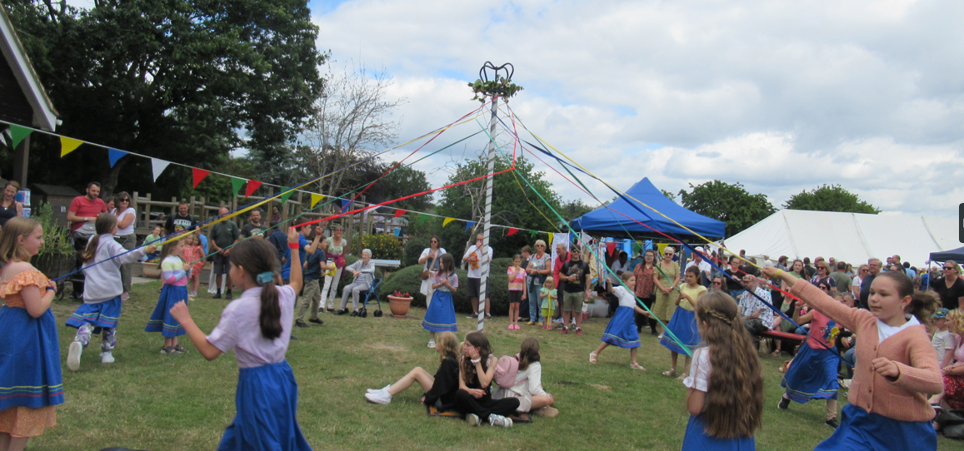
A good quality home/school partnership is essential to give children the best chance to flourish.
The first key factor is regular attendance at school.
This supports pupils’
academic development
but also their social
relationships and
well-being.

Slide 5
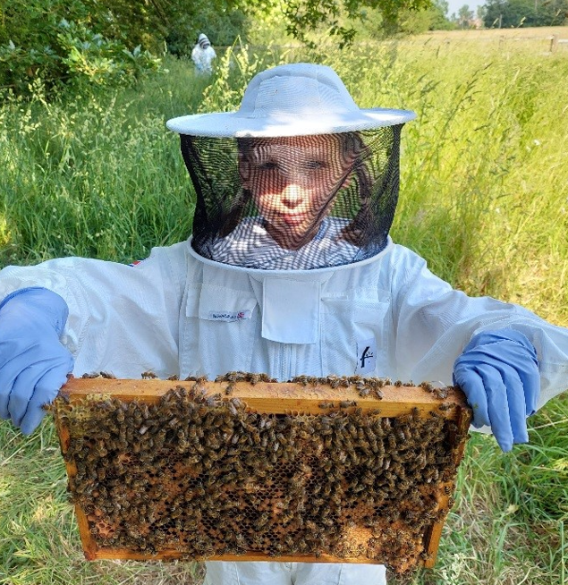
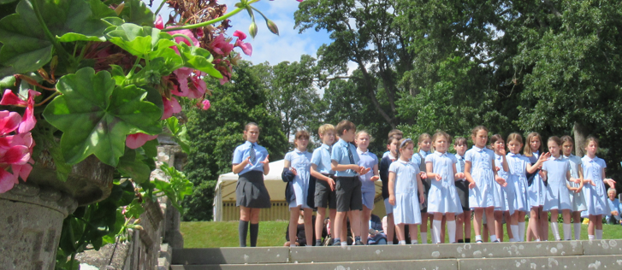
Encourage your child to make the most of the opportunities offered in school

Slide 6
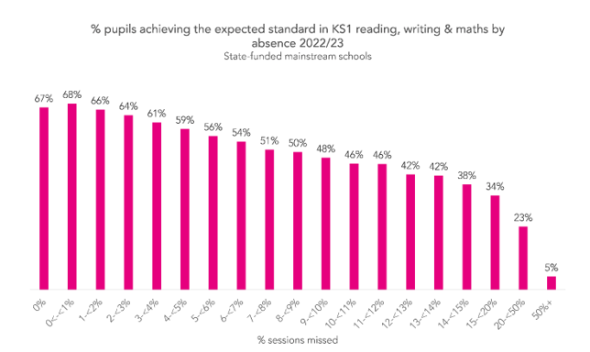

Slide 7
8% is approximately 15 days absence in a year

Slide 8
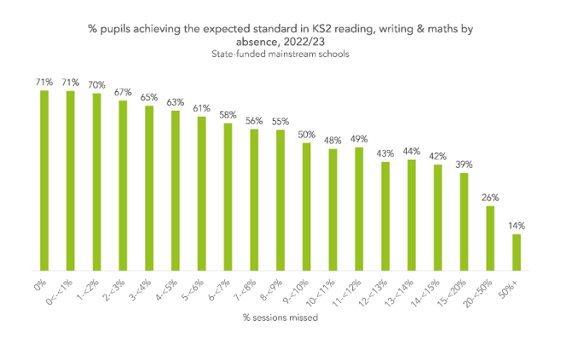

Slide 9
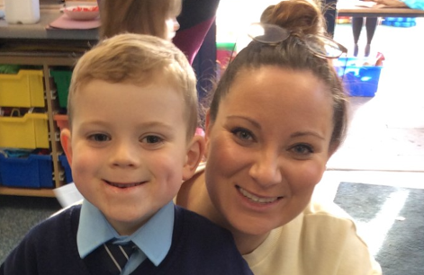
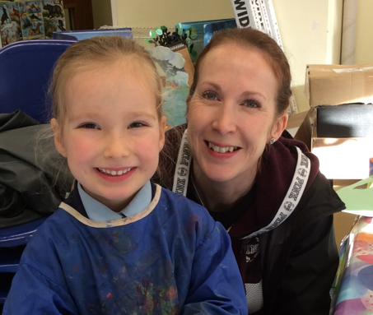
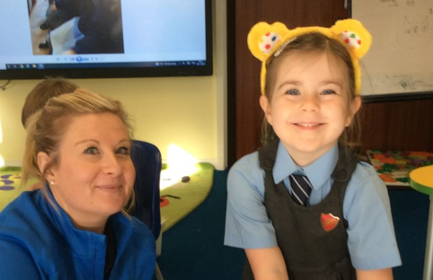
The second key factor is parents actively supporting their children’s learning at home.
This doesn't have to be a negative experience – learning should be fun!

Slide 10
The second key factor is parents actively supporting their children’s learning at home.
This doesn't have to be a negative experience – learning should be fun!

Slide 11
Try not to refer to any negative feelings or experiences you had yourself…unless they can be used to help your child.
The second key factor is parents actively supporting their children’s learning at home.
This doesn't have to be a negative experience – learning should be fun!

Slide 12
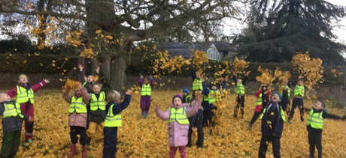
The Office for National Statistics carried out research in 2020 entitled:
Children’s views on well-being and what makes a happy life, UK: 2020
These are a couple of the things children felt were important…

Slide 13
Feeling loved and having positive, supportive relationships, particularly with friends and family, including having someone to talk to and rely on were consistently stated as a top priority for children to have a happy life.
A desire to spend quality time with family was expressed by children in relation to everyday things like having dinner together. This sentiment was also connected to parents paying attention to their children and "spending less time on their phones", for example.

Slide 14
Why are home-school partnerships important?
Research has found that parental or family involvement in school-based learning activities is correlated with improved student outcomes. A comprehensive meta-analysis comparing a wide range of educational interventions found that parent involvement had a larger effect on student academic achievement than most other interventions. Other longitudinal studies suggest parental involvement is more strongly connected to achievement and attainment than the family’s socioeconomic background, ethnicity or family structure. Parental involvement is associated with better psychosocial adjustment and higher achievement at age 7 and at age 11, although the findings on the impact on adolescents’ learning is mixed. However, the benefits of parent involvement in one school subject or area are also found to be confined to that area, that is, parent involvement in reading improves students’ reading attainment but not their attainment in mathematics.
The Education Hub 2019

Slide 15
The research base correlates parental involvement in school activities with:
Improved student outcomes/achievement, in some cases
Higher homework completion rates, more time spent on homework, and more effective
learning through homework
Students’ self-regulation, social skills, better behaviour and discipline
Lower drop-out rates and better attendance
Students’ positive engagement with peers and adults, and enhanced relationships between
parents, teachers and students
Increased feelings of competence or capability, positive engagement with learning and
motivation to learn, persistence, and mastery goal orientations in which students seek
challenging tasks and persist with academic challenges
High student aspirations with regard to education, and a greater likelihood of enrolling in
higher education
Family members’ increased involvement in adult education opportunities

Slide 16
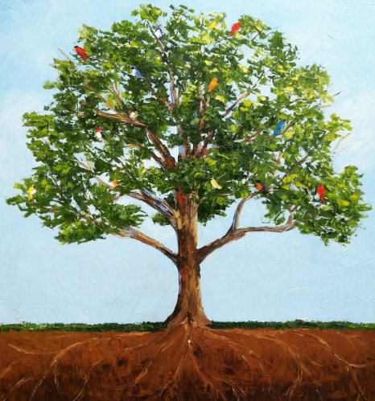
If we can combine quality family time with supporting learning, especially reading, our children will flourish.

Slide 17
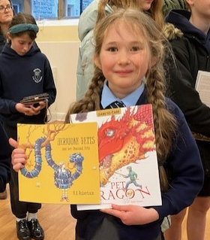
Reading & Language – what the research says
Indirect vocabulary learning
Children learn the meanings of most words indirectly, through everyday experiences with oral and written language.

Slide 18
Reading & Language – what the research says
Indirect vocabulary learning
Children learn the meanings of most words indirectly, through everyday experiences with oral and written language.
Children learn word meanings indirectly in three ways:
They engage daily in oral language
They listen to adults read to them
They read extensively on their own

Slide 20
Reading
Reading is an essential skill which enables children to access the rest of the school curriculum.
It is always best to start with developing a love of reading and stories.
Read to and with your child every day.
When they are older, continue to share texts that interest them e.g. sports pages in the paper or online

Slide 21
So what else can you do?

Slide 22
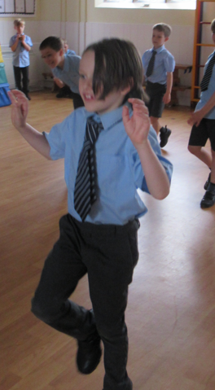
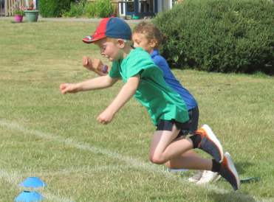
Physical Skills
Gross motor skills
throw and catch
bat and ball
bike/scooter/skates
family walks
geo-caching
kitchen disco!

Slide 23
Physical Skills
Gross motor skills
throw and catch
bat and ball
bike/scooter/skates
family walks
geo-caching
kitchen disco!
Fine motor skills
mark-making
dot-to-dots
colouring
tweezer games
playdough
finger-knitting
sewing
crafting

Slide 24
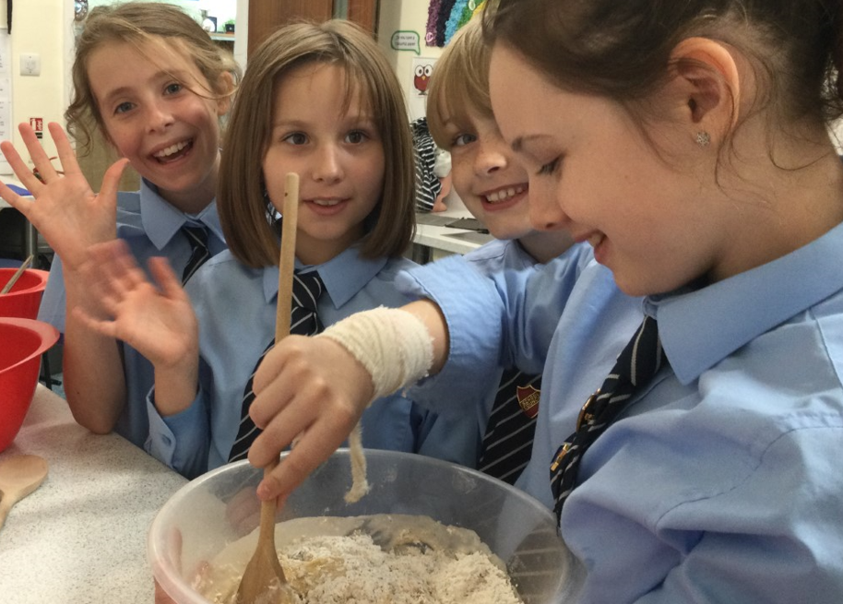
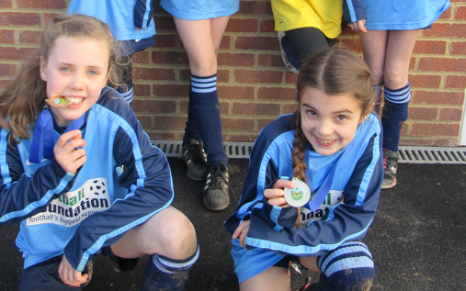
Social skills
Play dates
Joining clubs
Beavers / Cubs / Rainbows / Brownies
Mixing with other older people e.g. family friends
Church

Slide 25
Other key skills
Playing card games and board games is wonderful for teaching so many skills:
turn-taking
patience
delayed gratification
learn to win and lose with good grace
maths (matching, colour & shape names, adding on, sorting, adding up…)
language through discussions about the game
…all whilst having fun together

Slide 26
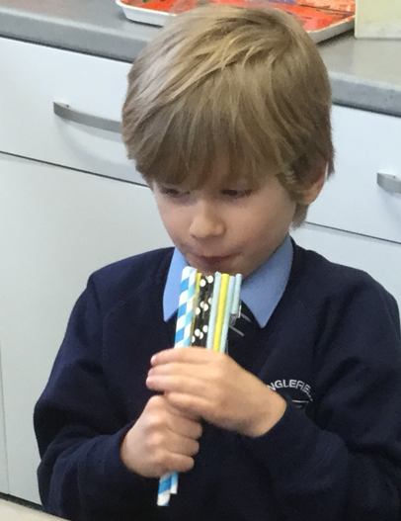
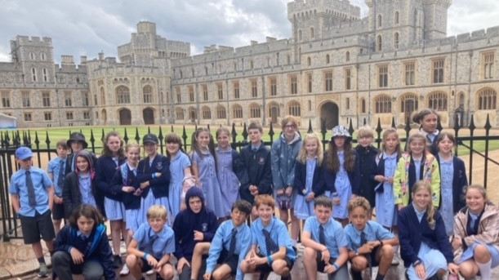
Other Ideas
Museums
Library
Special events
Newsround
Quizzes
Word and number puzzles instead of screens
Household jobs / responsibilities
Cooking / gardening
Junk-modelling

Slide 27
Supporting school learning

Slide 28
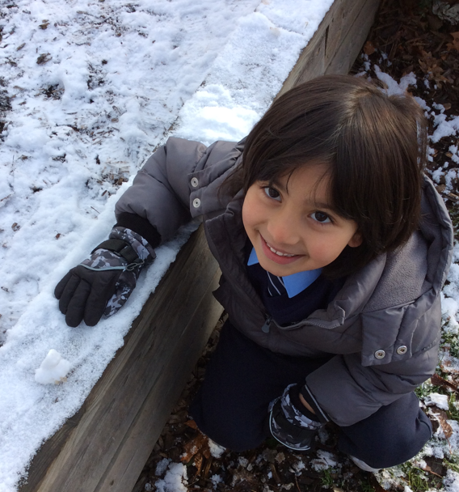
How to help at home
FS2, Year 1 and Year 2

Slide 29
Help your children to feel ‘ready to learn’
P.E. kit in school on a Monday and home on a Thursday for a wash
Suitable Woodland Learning clothes every Friday
Freshly filled water bottle in school every day
Footwear, coats etc. that they can operate themselves
Encourage enjoyment of own toys at home – it only causes upset if they are brought into school and are broken or lost

Slide 30
Make the most out of time with family and friends
Play turn-taking games
Accept winning and losing in real life situations
Enjoy trying many different foods
Remind your child that they have two ears and one mouth for a reason – listening is important
Encourage your child to share their ideas with enthusiasm and to enjoy the ideas of others with similar enthusiasm
Go out and enjoy all weathers – remember it’s only the clothing that can hamper the fun!

Slide 31
Encourage independence
Carry own bags
Tidy up after playing with something – this will help them treasure the resources at school as much as they do their precious things at home
Lay the table
Get clothes and bags ready the night before
Dress themselves
Learn to do up buttons and laces
Learn to use the toilet independently

Slide 32
Let’s not forget the academic learning!
Read! Read! Read!
Enjoy reading to your child as regularly as possible as this helps them see how books work. Talk about character, setting, events, predicting etc. Review each book together and compare and contrast to other books read. Talk about authors and illustrators.
Don’t forget to vary your reading by including some non-fiction and poetry.
Please spend at least 5 minutes reading and/or practising sounds (phonics) daily. This regular reading enables the children to flourish in their reading and supports them to access the curriculum independently.

Slide 33
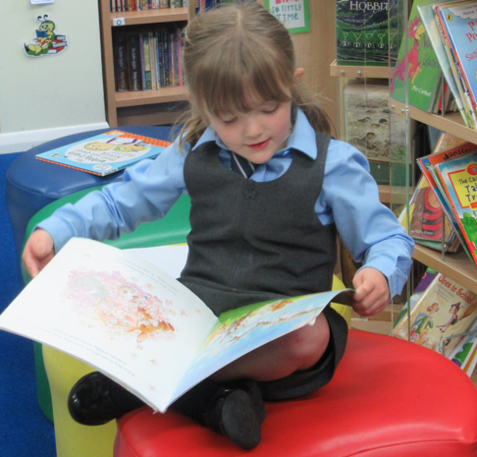
Reading Tips
Use the pictures to talk through what might be happening and to develop their vocabulary.
Give your child time to work out the words
through blending sounds and recognising sight
vocabulary (they are unlikely to be able to decode
‘could’ through blending sounds but might
recognise it).
Talk about why characters acted as they did.
Predict what might happen next.

Slide 34
In addition to reading…
Talk about ‘wobbling’ – it’s how we know we are learning.
Talk about the school day – there is a lot of information on the class pages on the website so you know what they should be learning.
Ask closed questions about the school day if your child is reticent to share e.g.

Slide 35
In addition to reading…
Talk about ‘wobbling’ – it’s how we know we are learning.
Talk about the school day – there is a lot of information on the class pages on the website so you know what they should be learning.
Ask closed questions about the school day if your child is reticent to share e.g.
What was the best thing you did today?
Surprise me with something you learned today.

Slide 36
In addition to reading…
Take every opportunity to practise counting on and back in ones, twos, fives and tens – e.g. when laying the table, in the car on the way to school, as part of a catching game.
For Year 2 children, please encourage them to complete the Maths Homework sheets that are sent home on a Friday. Please could enthusiastic parents curb their desire to beat their children to the answer! Let your child have the first attempt then feel free to discuss with them any misconceptions but please make all of this easy for us to see when marking
by using
Help learn those tricky words (that cannot be spelt phonetically) in as many different ways as possible. Age appropriate word lists and imaginative ways to practice spelling these words will be sent home shortly.
S

Slide 37
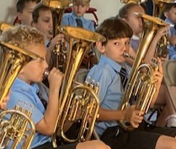
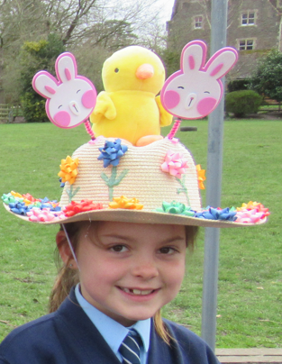
How to help at home
Years 3 and 4

Slide 38
Encourage greater independence
By giving your child jobs to do, you are showing you trust them.
Ask children to help do the shopping so they get used to finding items in the shop, comparing items to find the best value, working out if they have enough money, packing shopping with heavier items at the bottom.
Encourage children to plan how to use pocket money – are they going to save for a few weeks to buy something that costs more? Have they thought carefully about their planned purchase – will they use it enough to make it a good choice?
Arrange more play dates and sleepovers in readiness for school residentials.

Slide 39
Shared Learning & Homework
Homework comes home in their blue folder every Friday and should be returned by the following Thursday.
Focus on the practice-style homework (times tables, arithmetic, reading, spelling, comprehension) - do support your child with this but make sure they have a go first as that’s how they will learn.
With maths, ask them to show you the ‘school way’ so we don’t confuse the issue.
Find something they enjoy on the Shared Learning grid or come up with something between you – a visit to a museum, a presentation about a hobby – the aim is for this to be fun, to develop a love of learning.

Slide 40
Additional Support
These are crucial years so if your child receives additional support in school, e.g. with spelling or maths, try to put time aside to do more at home – it will really help them going forward.
Repetition is key.
Look for small steps of progress and celebrate these.
Keep this support going through the holidays.
Make sure your child has the opportunity to do activities they succeed at as well – it can be quite disheartening to only spend time on things we find difficult.

Slide 41
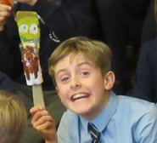
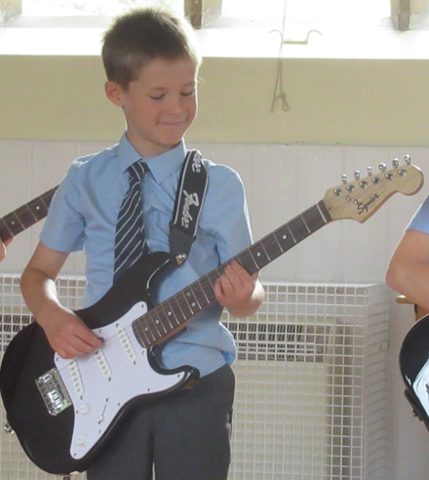
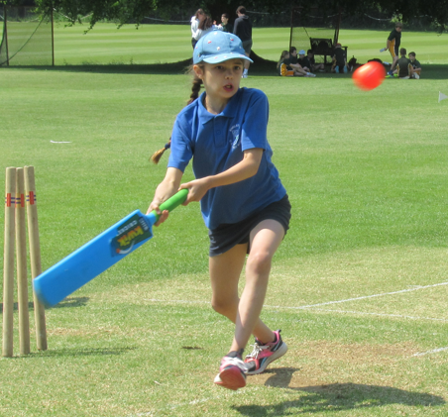
How to help at home
Years 5 and 6

Slide 42
Homework
In year 5 and 6 pupils are becoming more independent.
In addition to daily reading and online spelling practice, Year 5/6 will bring home 2 pieces of homework a week: arithmetic and reading comprehension.
Arithmetic is given on a Monday and reading comprehension is given on a Wednesday.
Giving pupils homework on different days and giving them a degree of choice as to when they complete it, allows them to practise the skills of time management. This will help them to be more self-sufficient in Year 7.

Slide 43
Pupils are expected to take responsibility for bringing in their homework when it is complete and keeping it in their tray until it is time to mark it. This helps them improve their organisational skills.
In Year 5/6, homework requirements are recorded by the pupils in their own homework diaries - allowing for them to take responsibility for their own learning.
Whilst pupils are rewarded for completing homework, it is not policy to enforce sanctions for non-completion. This enables pupils to feel pride when they complete it but not shame if they have struggled that week.

Slide 44
Helping Year 5/6 at home
Please check that your child has brought their homework home at some point during the week. The weekend might be a good time to complete it if families are busy.
Please check that pupils read daily during the week and sign the reading and homework diary once per week ready for checking on a Friday.
Please encourage pupils to practise their spellings and maths skills using Ed Shed at home.
Enjoy completing shared learning every few weeks- and encourage pupils to take their time and complete projects thoughtfully.

Slide 45
Please contact Miss Langston if there are any areas of the homework that your child struggles with - she can help to reassure you and your child and can always signpost helpful websites to support further learning if necessary.
Remember that some pupils are extremely tired after a full day's learning and may not be able to manage homework in the evening, especially if they have additional needs. This is why pupils are given a week to complete the homework.

Slide 46
What if my child is struggling?
We know some individuals struggle with organisation and time-keeping. We do make allowances for this when the children are in school, however it can make getting ready for school quite tricky for the family.
Try having everything ready for school the night before - have a checklist (with photographs) of what is needed each day.
Use a smiley face chart that they can fill in for each item.
Set alarm clocks 15 minutes early to give yourself extra time.

Slide 47
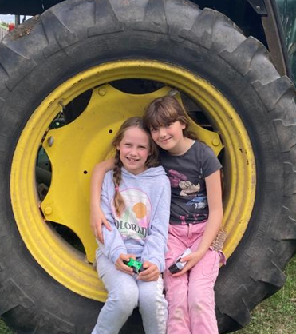
And finally…
Please talk to your child’s teacher if there is anything you are worried about or if you are struggling to engage your child at home. We might have some tips that other parents have used successfully.

